Slide 1
E-commerce mobile application GROUP NO:04 PRESENTING YOU JF INFOTECH

Slide 2

Project Co-Ordinaor Name : Prof. Rehaal Qureshi
GROUP MEMBERS :
1.RUKAIYA KOCHIKAR - 18CO06
2.MOHD HUSAIN DARJI - 18CO21
3.WASIM JAFAR SAIFEE - 18CO45

Slide 3
Introduction
E-commerce (electronic commerce) is the buying and selling of goods and services, or the transmitting of funds or data, over an Electronic Network, primarily The Internet. These business transactions occur either as business-to-business (B2B), business-to-consumer (B2C), consumer-to-consumer or consumer-to-business.
Objectives :
1. Reduce management costs
2. Developing business relations
3. Providing a unique customer experience
4. Increasing sales
5. Increasing the number of loyal customers

Slide 4
Literature Review
As an eCommerce application store volumes of data about products and the users that register to buy on the app, so safety is one of the most crucial eCommerce app requirements. Any breach of this data puts business at risk; it leads the contact information could be stolen and sold on, or you could permanently lose essential data. The first way to attract mobile shoppers is to make sure online store loads quickly and is easy to navigate. App design work, that means adapting the site designed to appear on a big desktop monitor so that it works on a 5-inch or smaller smartphone screen. Websites with complex user interfaces are abandon by the customers. Hence, the accessibility is an essential part of designing an ecommerce website. There are many ways to evaluate the accessibility and usability of a website [8]. User's don’t have time to learn to use an app and it is observed that users do not want to spend time to learn. It's true why would anyone need to learn each time to use it. It's strange to build such an app that's not GUI friendly.[9], keeping this in mind we have designed our app.

Slide 5
Literature Review
The ultimate way to give your store a functional presence on a smartphone or tablet is to create an app for it. An app performs lots of essential business
functions:
✓ It’s embedded into the device. Once a user downloads and installs an app, it’s there in the device. It is assigned a shortcut, and the user can place that shortcut right on his or her home screen for the ultimate in convenience.
✓ It promotes products. If you have Groupon’s popular app, you know that the daily deal site uses the app as a promotional tool; you see today’s special deals the moment you open it up.
✓ It makes your site easy to use. The app can be configured to store user information so it doesn’t have to be entered at checkout; a purchase might take just one or two clicks

Slide 6
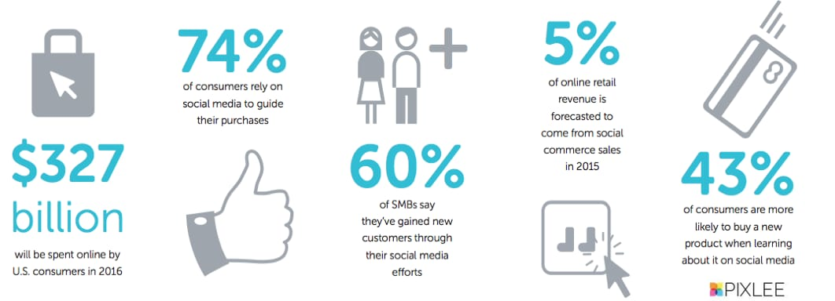
Literature Review
Advantages:
1. Low Cost Than Offline Business
2. Businesses Can Operate From Anywhere
3. Scalability
4. 24/7 Open
5. Can be Measured Better Than Other Sales Approaches
6. Less Time Committed
Disadvantages:
1. Technical implications
2. Competition within the ecommerce industry
3. Missing personal touch and instore engagement
4. Customers can’t try before they buy
5. Shipping times

Slide 7
Relevance to Social Benefits to Proposed Idea
1. Expand our online reach
Considering 71% of adults with Internet access use social media, almost every business can benefit from marketing on platforms like Facebook, Twitter, and Instagram. This is especially true for ecommerce retailers.
2. Reach our target audience where they spend the most time
Optimizing your site for search engines and running PPC campaigns allows you reach users while they’re actively searching for specific products, but with social media, you can also reach them on their favorite places online.
3. Engage our target audience in a casual way
Social media platforms also offer a much less formal way of communicating with potential customers than any other advertising channel, making it easy to engage in two-way conversations with users who are interested in learning more about your products.
4. Help our brand get shared online
Given the nature of social media, it allows your current customers to share your brand with their family and friends — an ideal situation for any online retailer.

Slide 8
Details of Functional Requirement with Justification
Functional requirements This section provides requirement overview of the system.
Various functional modules implemented by the system are as follows -
Registration : If customer wants to buy the product then he/she must be registered, unregistered user can’t go to the shopping cart.
Login : Customer logins to the system by entering valid user id and password for the shopping.
Changes to Cart: Changes to cart means the customer after login or registration can make order or cancel order of the product from the shopping cart.
Payment : In this system we are dealing the mode of payment by Cash.We will extend this to credit card,debit card etc in the future.
Logout : After ordering or surfing for the product customer has to logout if a customer doesnt log out.

Slide 9
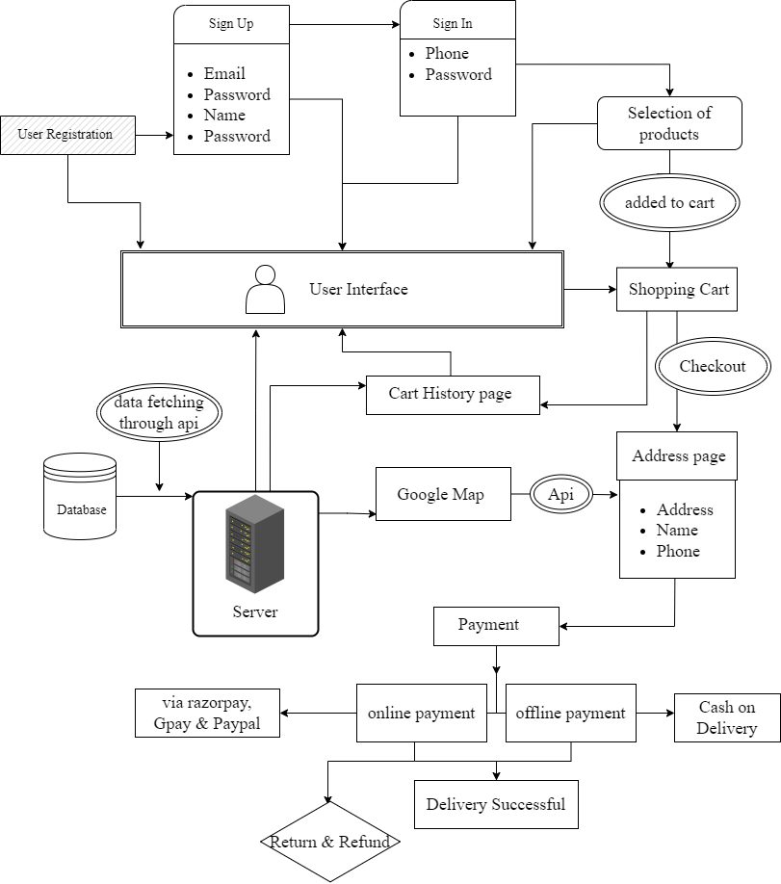
Proposed System Architecture

Slide 10
Market Potential of System
Every customer from all over the world can find the site, product, and information without leaving the house. In e-commerce, we do not need to visit the business physically. The facilities of the physical firm are not the criteria to be taken into account. We can buy from us at home; users can easily choose products among various procedures without having to physically move.
E-commerce has transformed the way business is done in India. The Indian E-commerce market is expected to grow to US$ 111.40 billion by 2025 from US$ 46.2 billion as of 2020. Much of the growth for the industry has been triggered by an increase in internet and smartphone penetration. As of April 2021, the number of internet connections in India significantly increased to 782.86 million, driven by the ‘Digital India’ programme. Out of the total internet connections, ~61% connections were in urban areas, of which 97% connections were wireless

Slide 11
3.8 Billion users
100%
Till number means over 43% of consumers worldwide shopped online in 2020.
Mumbai: The Indian ecommerce market is expected to grow by 21.5% and hit $74.8 billion in 2022, according to GlobalData, a data and analytics company.
Total success!

Slide 12
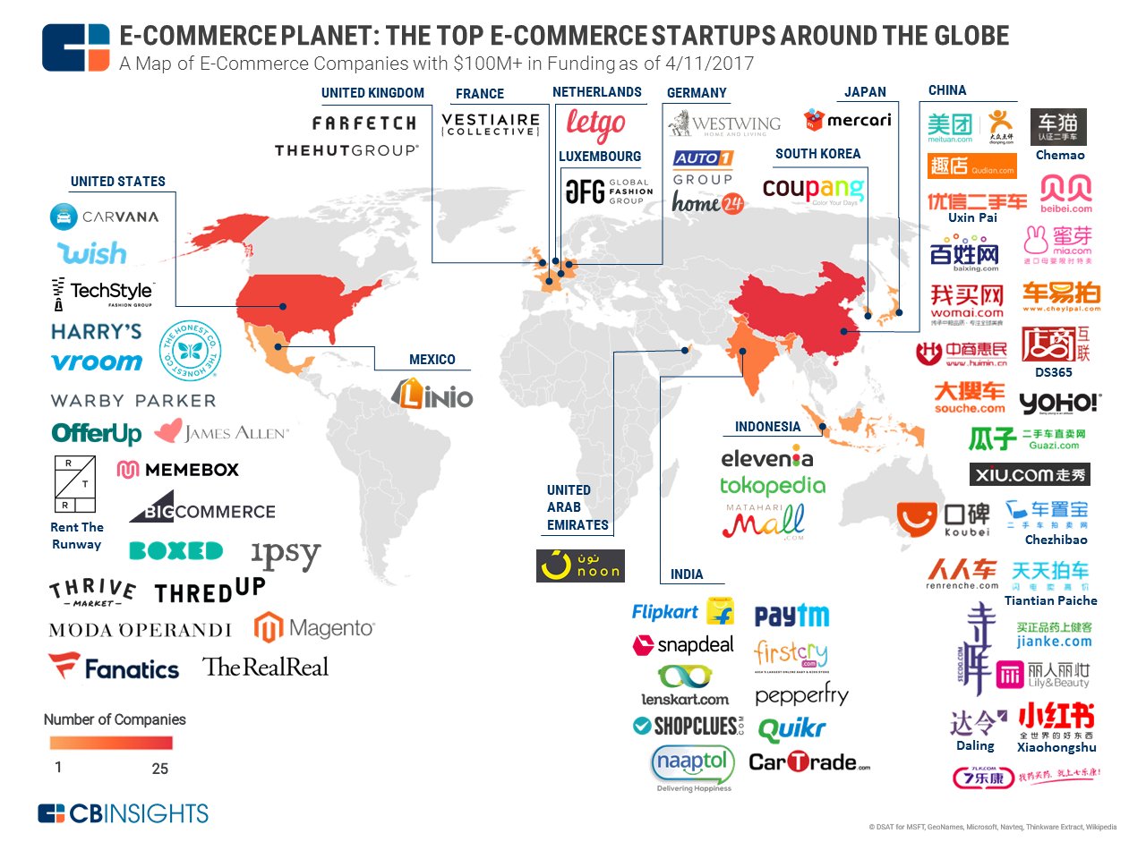
Maps

Slide 13
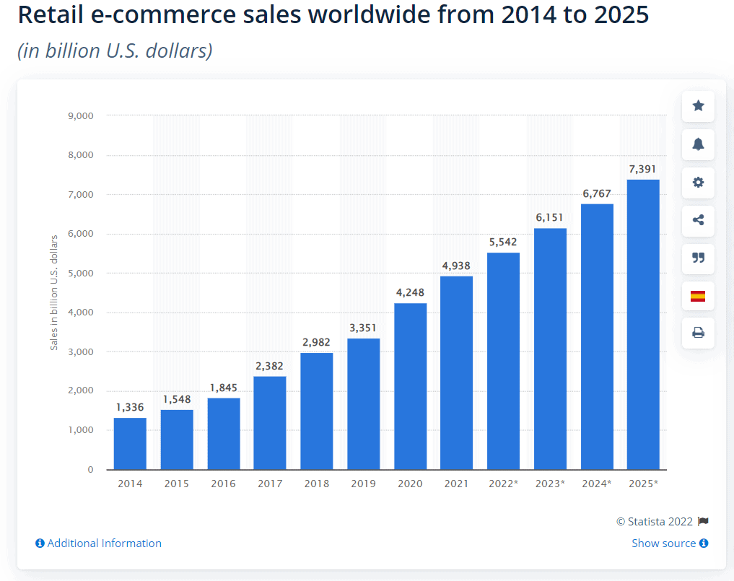
E-commerce Business Growth from past Eight years and Future Prediction till 2025

Slide 14
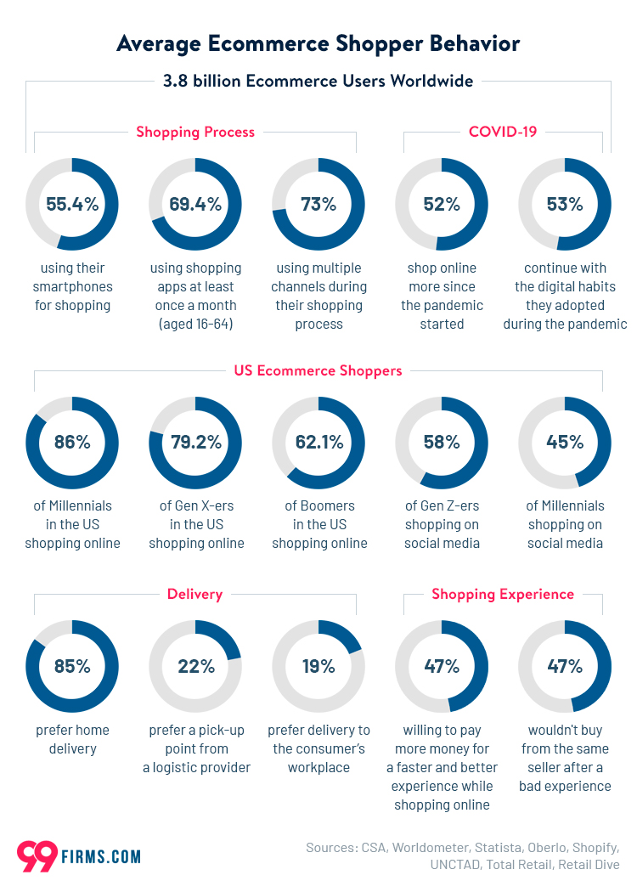
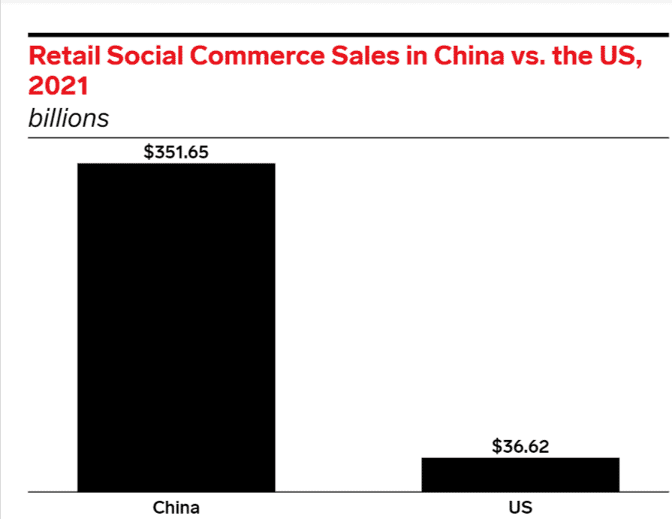
Research Says

Slide 15
Major Features
Show products based on category
Shopping Cart
Place Your Order
Track Order
User Profile
Sign in & Sign up
User Address location using Google Map
User Authentication

Slide 16




App Icons

Slide 17
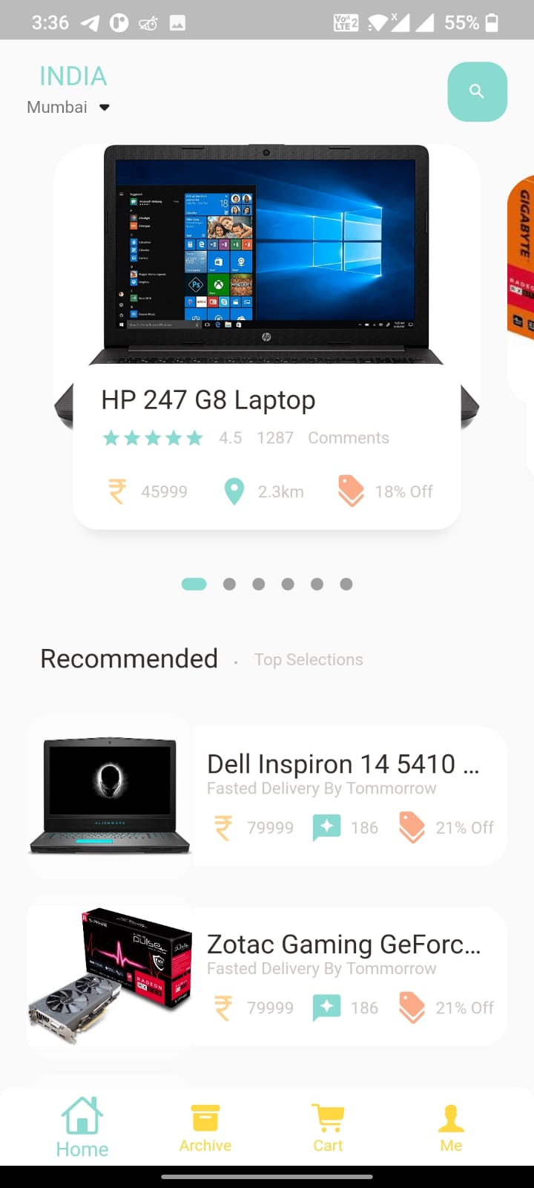
Mobile project
Containes two catogaries of product
one is popular products & other is recommended

Slide 18
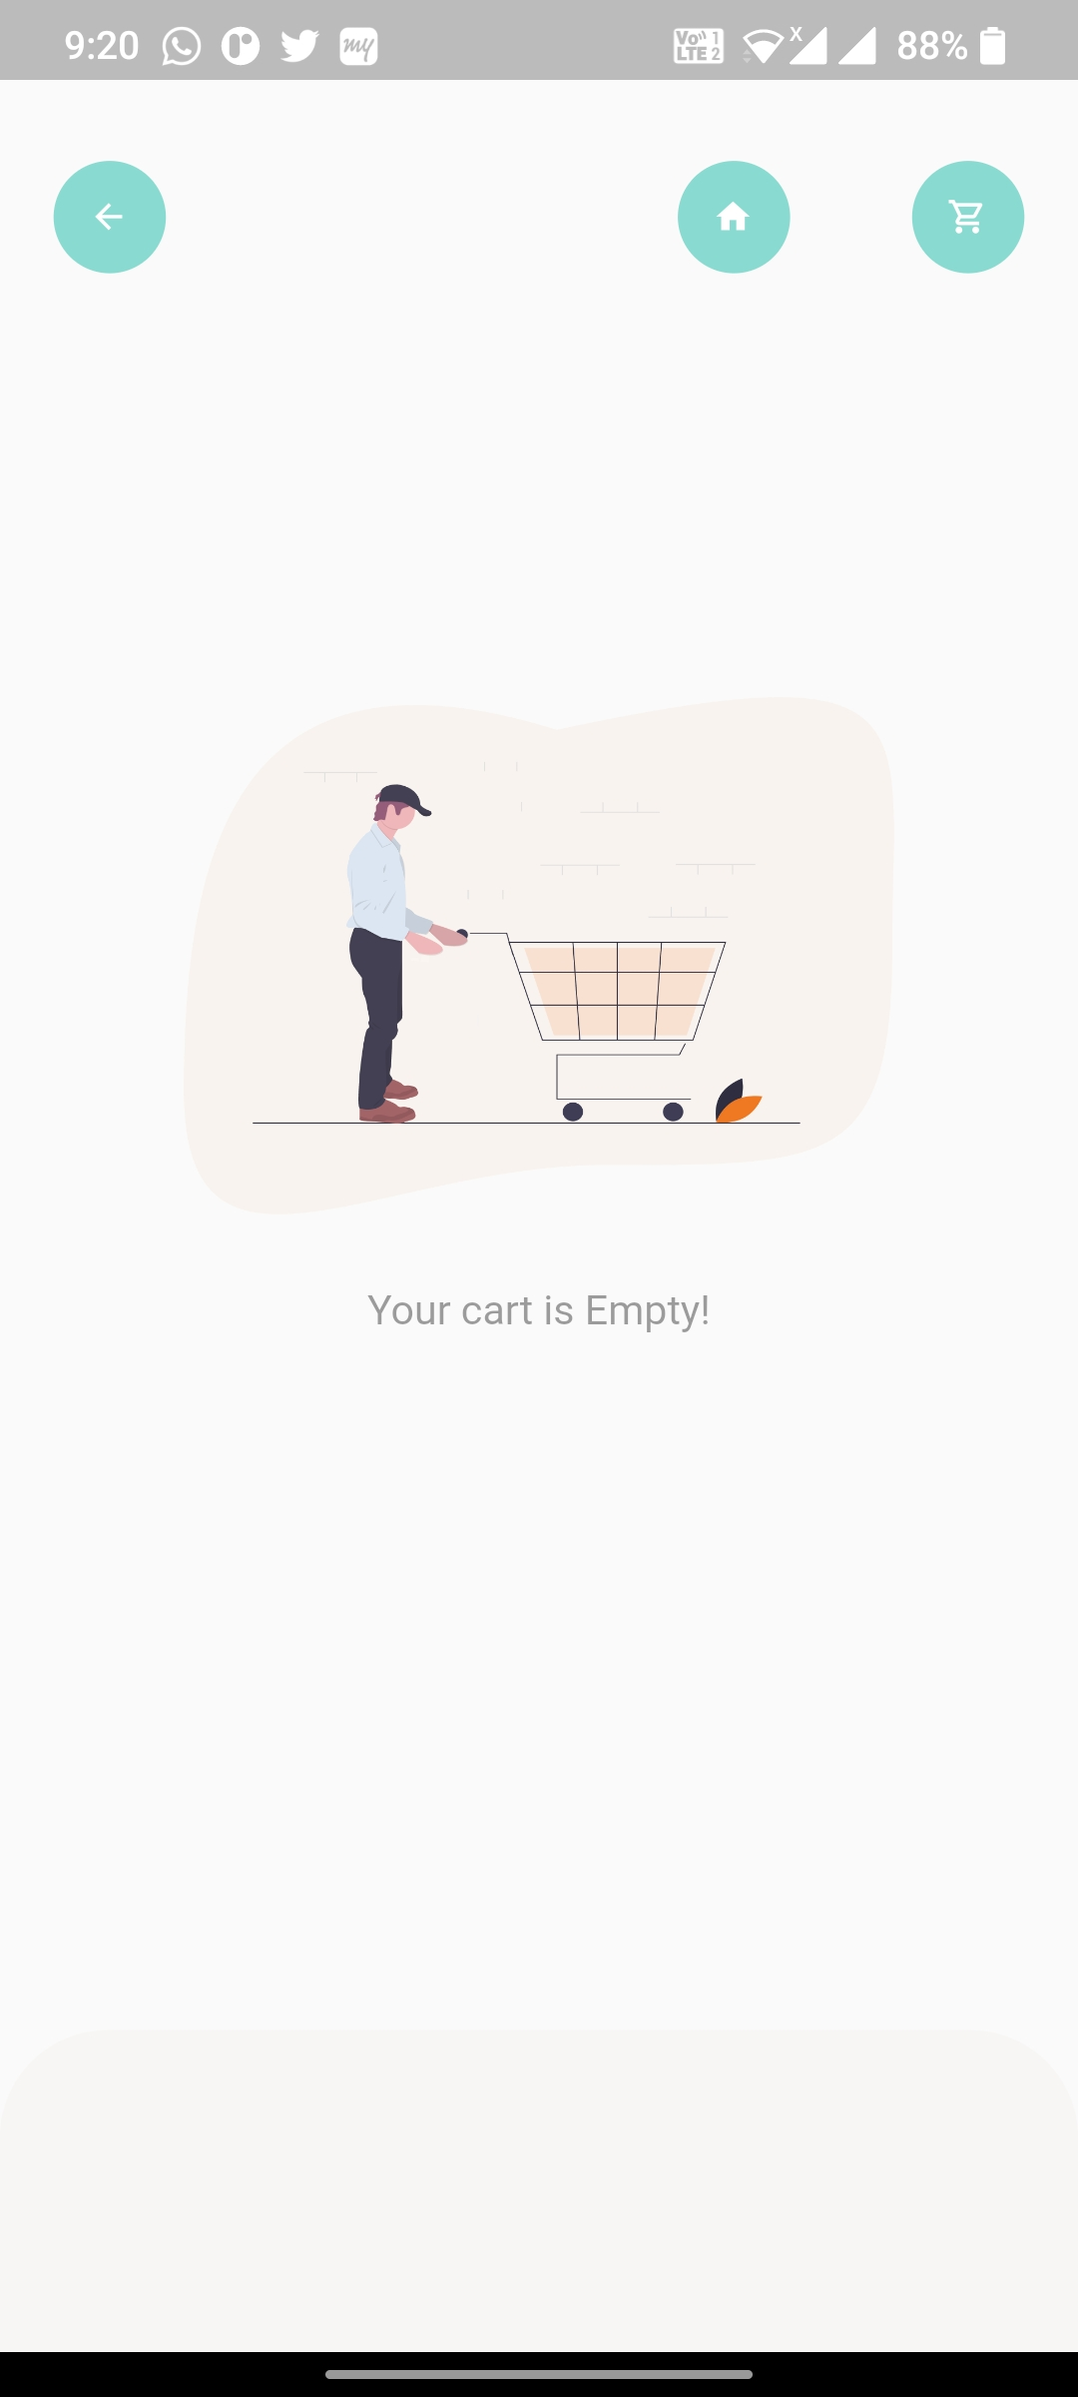
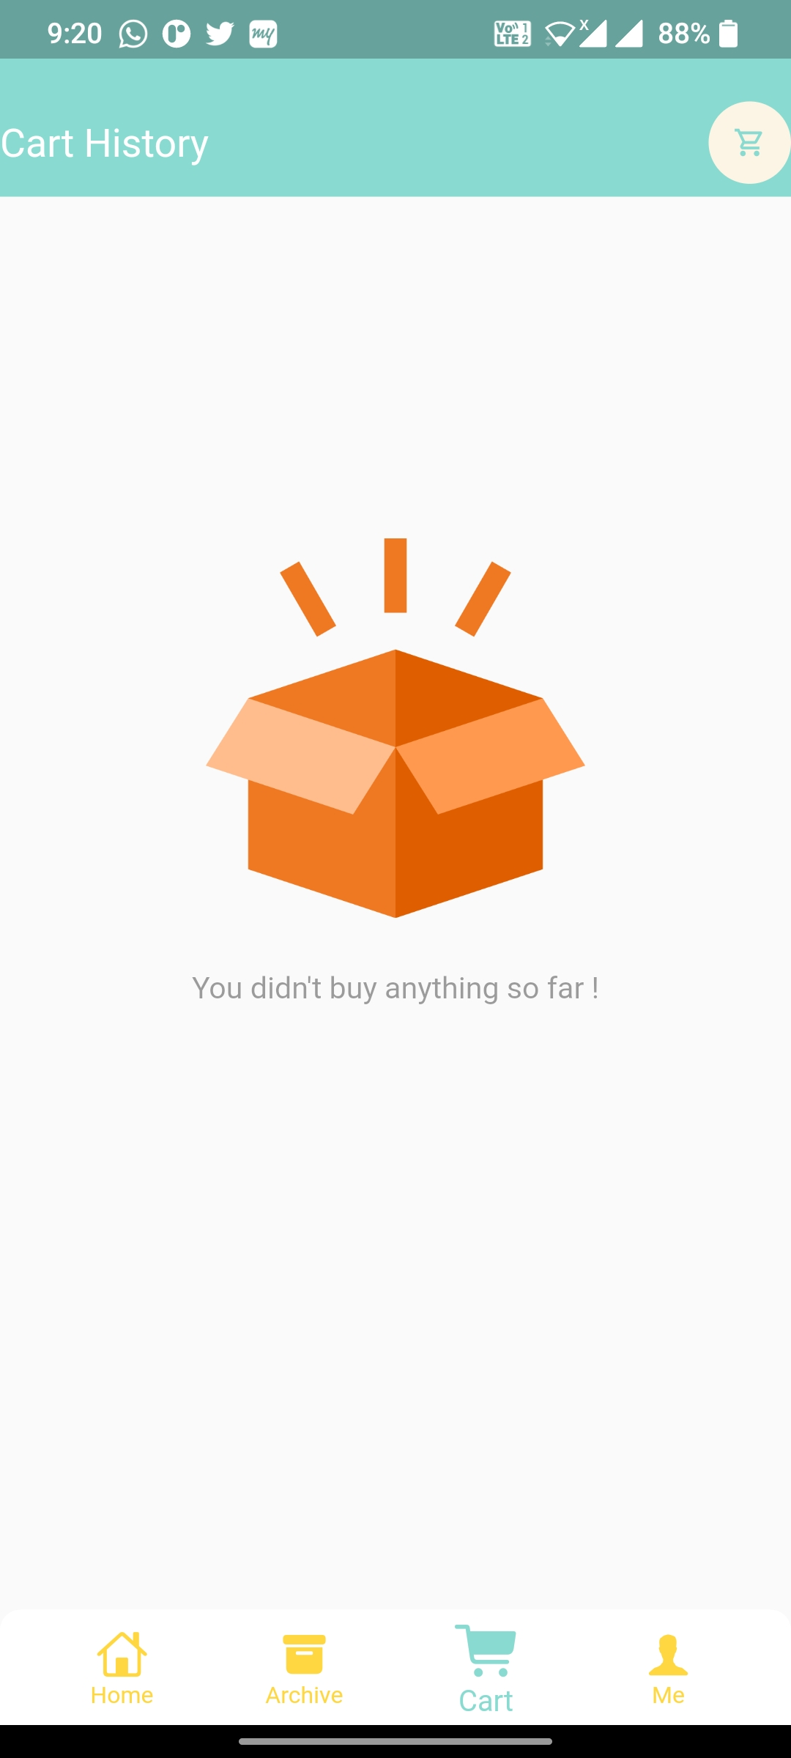

User Interface
Cart Page
Cart History Page
Splash Screen

Slide 19
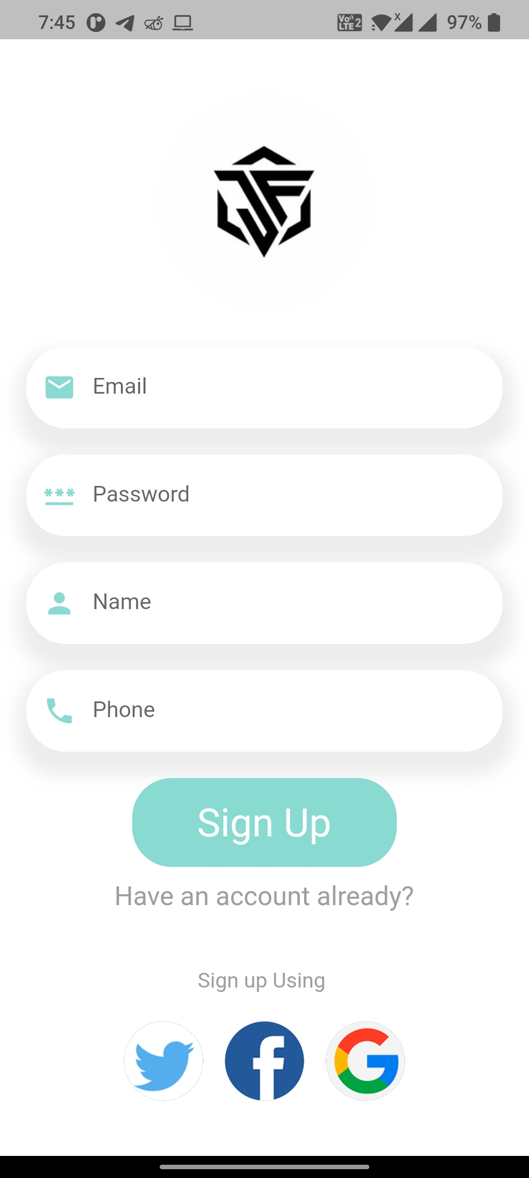
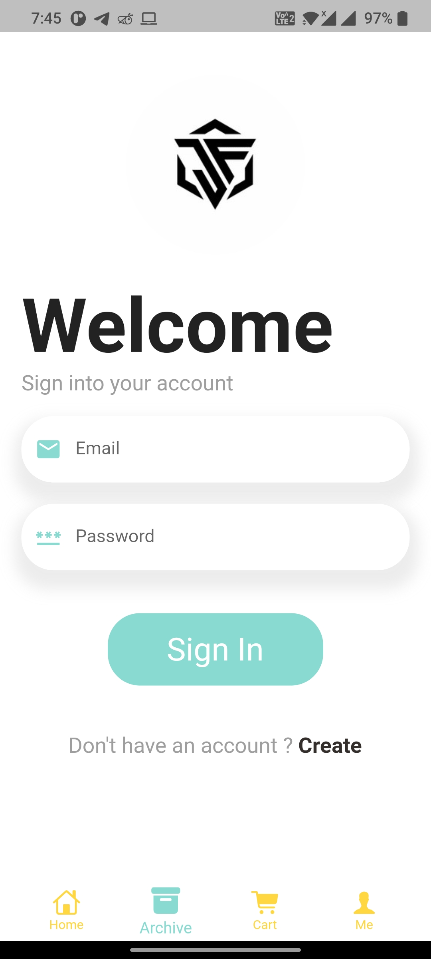
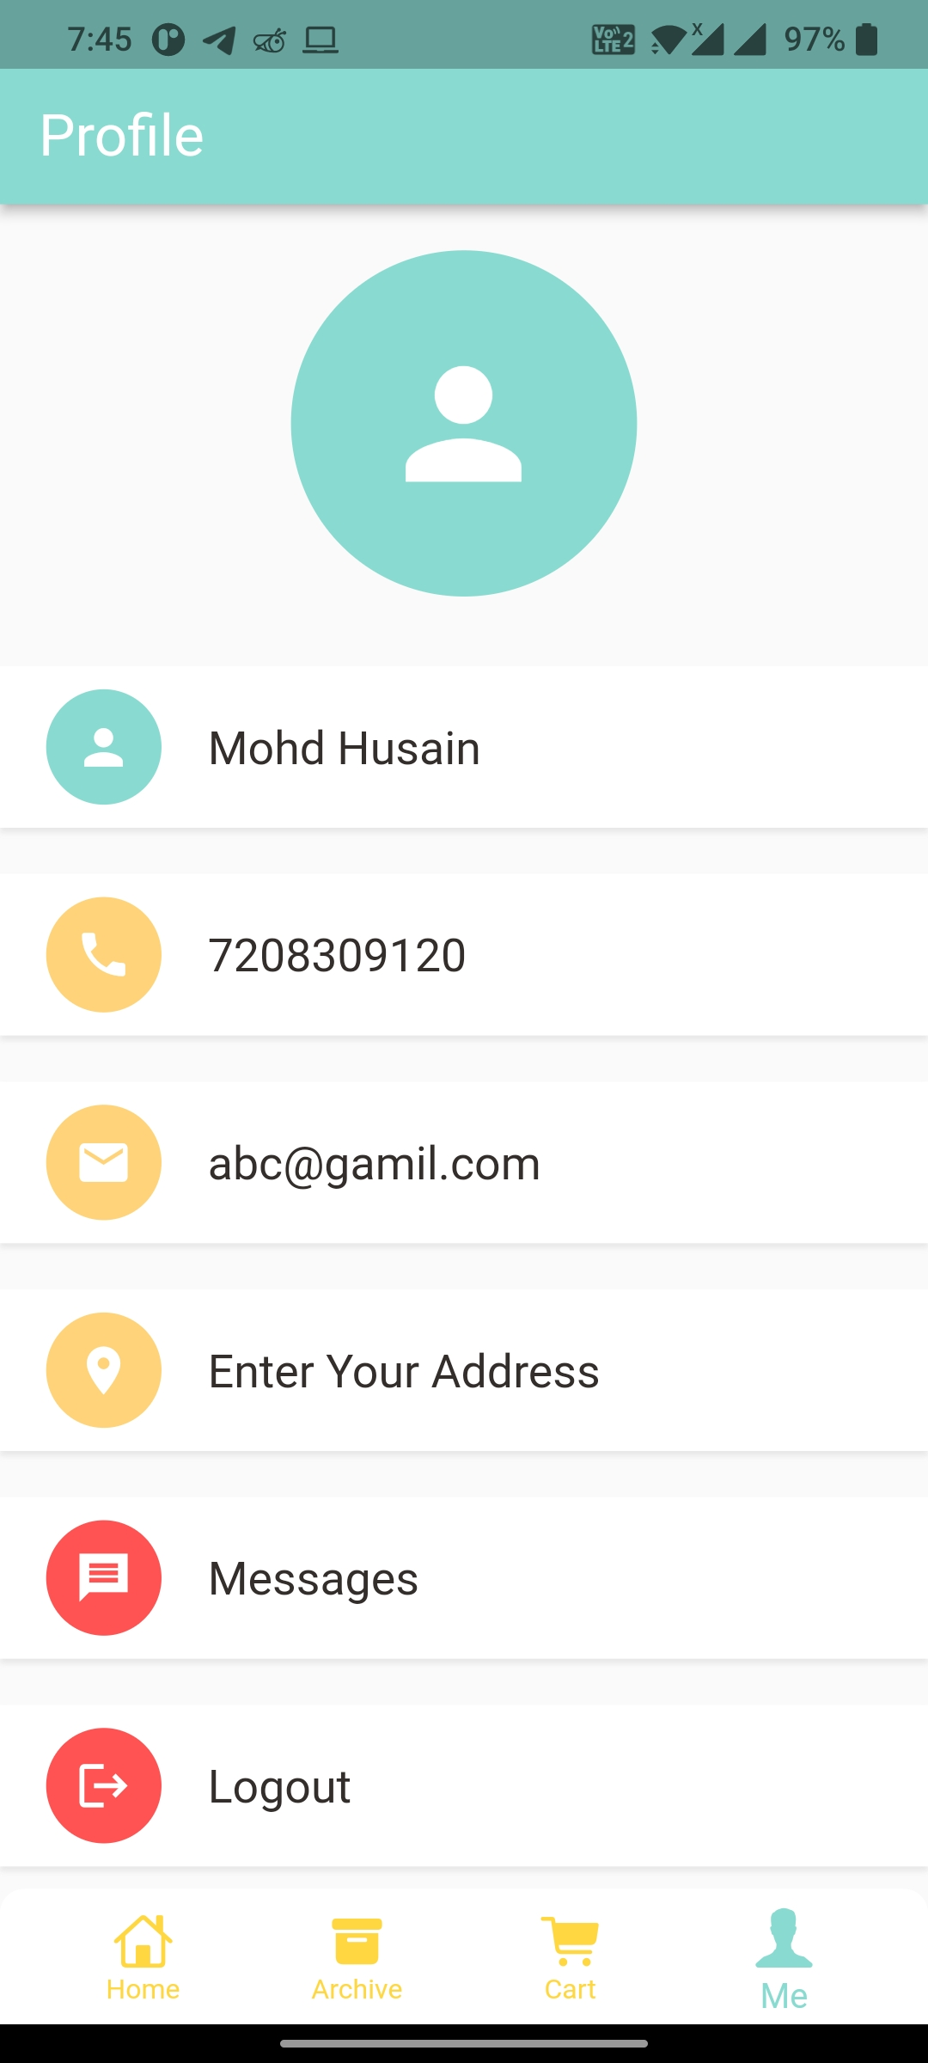
User Interface
Sign Up Page
Sign In Page
User Profile

Slide 20
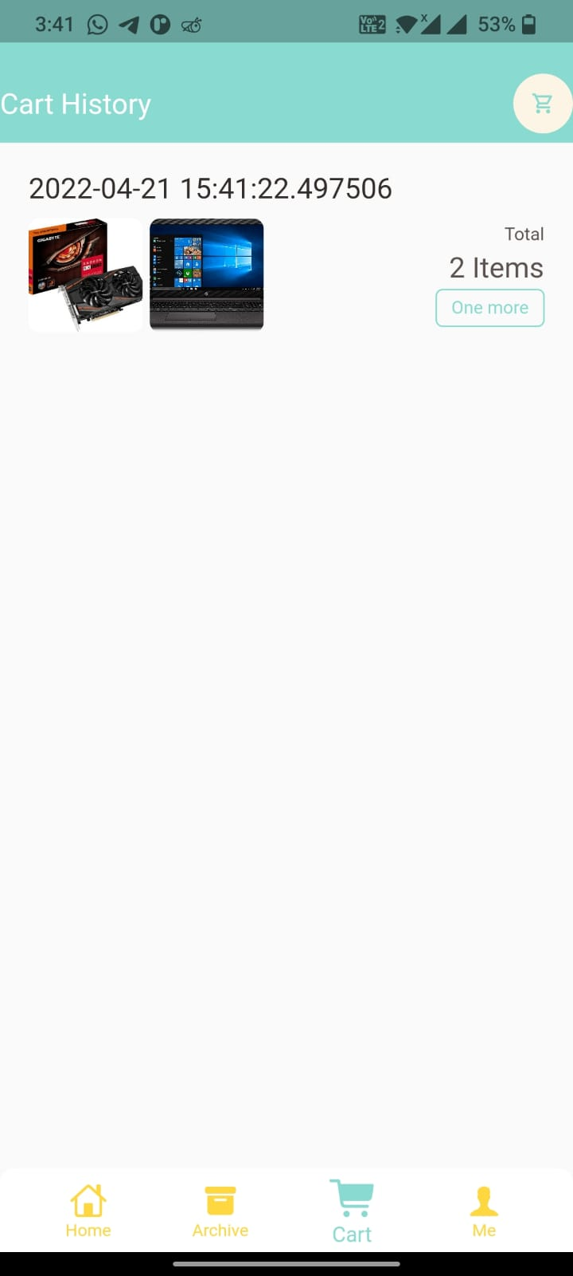
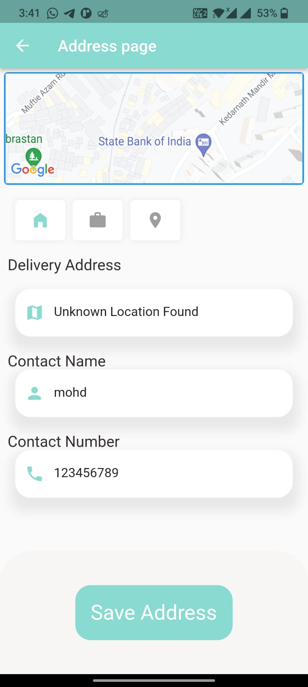
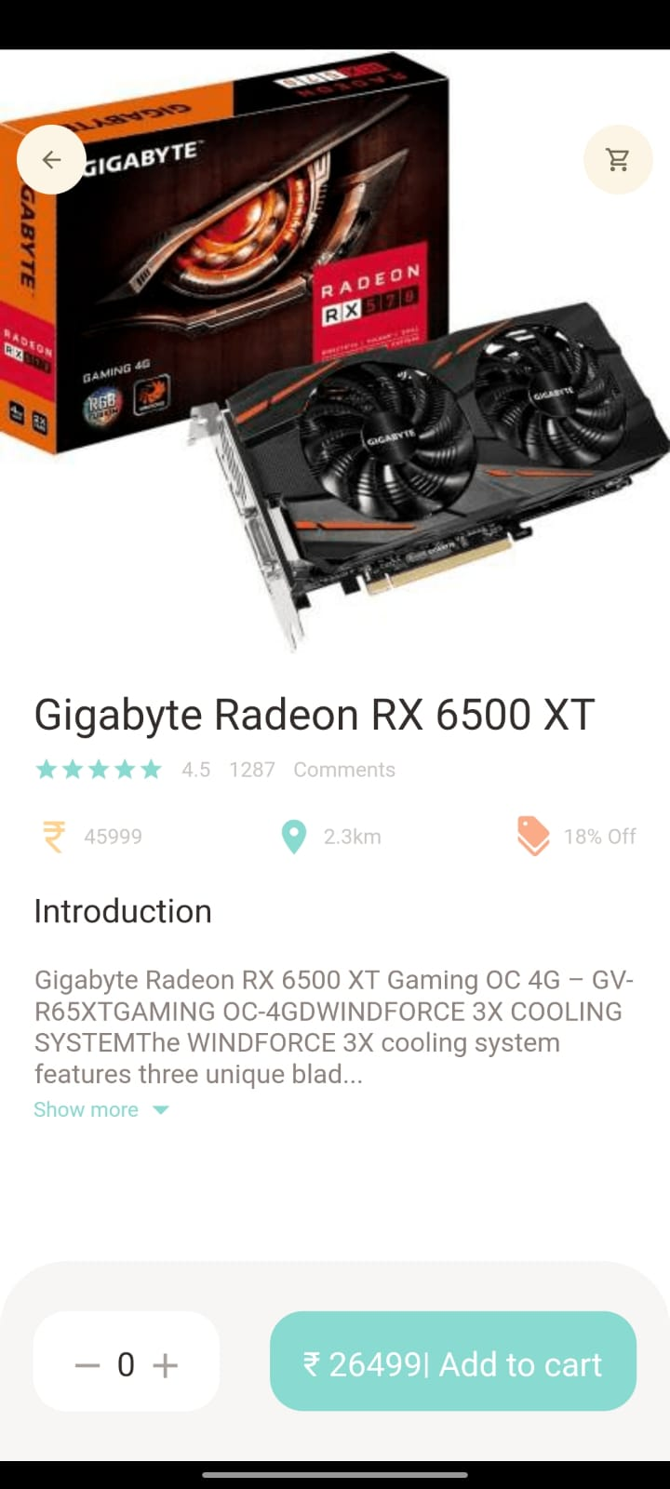
User Interface
Cart History
page
Address Page
Product Page

Slide 21





Technologies used
Flutter SDK
Dart Programming Language
Laravel (Backend)
SQL (Database)
APIs

Slide 22
Goals
The primary goal of e-commerce is to reach maximum customers at the right time to increase sales and profitability of the business. Functions of e-commerce include buying and selling goods, transmitting funds or data over the internet.
Measurable: Creating a mobile app for our company site will require a lot of resources.

Slide 23

Future plans
1.Business Growth:
The different sales channels implementation will definitely boost the revenue of the business and thus It will help all the people in their growth. The scope of e-commerce in future will see different approaches also when targeting more number of customers.
2.Different E-commerce Marketplaces:
The future scope of e-commerce is really going to have big growth potential in all the categories of items. The user experience is very good in all e-commerce application if they continue to provide best customer support in the customer’s online shopping journey. By analyzing the shopping experience, this has made clear thoughts on the scope of e-commerce success ratio. It is believes in pure customer satisfaction and customer service. A marketplace must has clear transparency about the products and the deals that are offered to the customers.
3.Offers and Discounts:
Offers and discounts to attract customer are also one of the reasons for soar in scope of e-commerce industry. People look for huge discounts and special promo codes when they want to shop online. As a result, they visit e-commerce sites to get the best deal for them.
4.Fast Shipping:
There are many shipping service companies which deliver the items in a very short amount of time. However, sellers have to pay high fees for it. Customers generally want their products to arrive in a very short period of time

Slide 24
Expected Results
The main way in which e commerce will affect the economy, in general, is its impact on productivity and inflation. The continued expansion of electronic commerce could also lead to downward pressure on inflation through increased competition, cost savings and changes in sellers' pricing behavior.

Slide 25
Conclusion
The Internet has become a major resource in modern business, thus e-commerce has gained significance not only from the entrepreneur’s but also from the customer’s point of view. For the entrepreneur, e-commerce generates new business opportunities and for the customer, it makes comparative shopping possible.
As per a survey, most consumers of online stores are impulsive and usually make a decision to stay on app within the first few seconds. “Application’s design is like a shop interior. If the design of shop looks poor. people perceive hundreds of other shops the customer is most likely to skip to the other site. Hence we have designed the project to provide the user with easy navigation, retrieval of data and necessary feedback as much as possible. In this project, the user is provided with an e- commerce web site that can be used to buy goods online. To implement this as a web application we used API as the Technology. API has several advantages such as enhanced performance, scalability, built-in security and simplicity.

Slide 26
Reference
References for Literature Review
[1] Patthandi Cheangtawee, Natspun Paopun, and Wanno Fongsuwan, “The Development of Key Performance Indicators for E-Commerce in Hotel Businesses Using Balanced Scorecard”, Proceedings of the Fourth International Conference on eBusiness, November 19-20, 2005, Bangkok, Thailand.
[2] Syed Emdad, Tania Alauddin and Hasan U. Zaman, “Developing an E-Commerce Website”
[3] Yot Amomkitvikai and Cassey Lee, “Determinants of E-Commerce Adoption and Utilisation by SMEs in Thailand”, January 2020

Slide 27
Reference
E-Commerce Planet: The Most Well-Funded Private E-Commerce Companies In One Map:::(https://www.cbinsights.com/research/top-ecommerce-startups-global-map/)
Retail e-commerce sales worldwide from 2014 to 2025
Chart:::(https://www.statista.com/statistics/379046/worldwide-retail-e-commerce-sales/)
www.Google.com
www.YouTube.com
www.Pinterest.com
www.pngtree.com

Slide 28
Demonstration

Slide 29



Team Presentation
Wasim Jafar
Backend Developer
&
Market Research
Mohd Husain
UI/UX Designed & Flutter Developer
Ruqaiya Kochikar
Full Stack
Developer
&
DBMS

Slide 30

Thank You!

